Slide 1
Lecture : Heap, Heap Sort

Slide 2
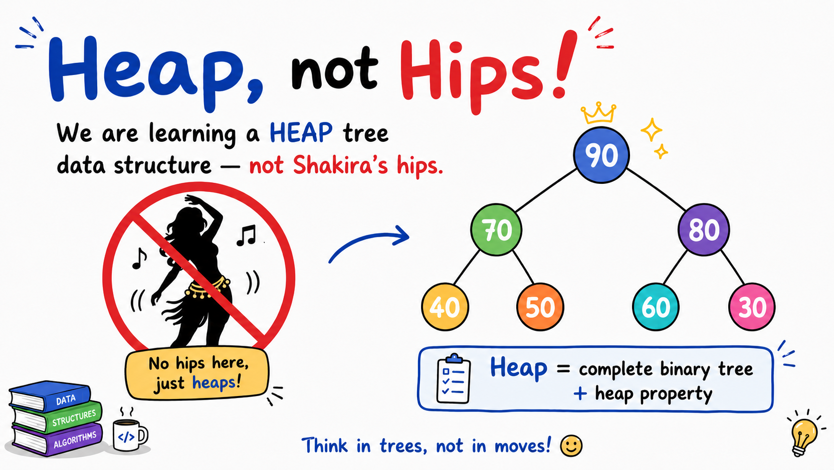

Slide 3
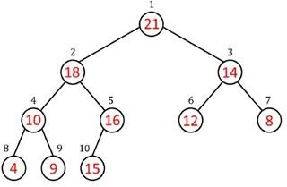
Heaps
Complete binary tree: All levels are completely filled except the lowest, every node should reside on the left side.
Heap is Not a BST,
Heap is a complete BT with heap property maintained
Must satisfy the heap property.
  Max Heap property for Max Heaps
  Min Heap property for Min Heaps
Heaps

Slide 4
Heap properties
Root: Only node with no parent
Leaf: Node without any children
Heap size: Number of nodes in heap
Height of a node is number of edges along longest simple downward path from node to a leaf
  Leaves have height h = 0
  Root in example above has height h = 3
  Height of root is height of tree/heap
In heap, Height of tree is ALWAYS Θ(h) = Θ(lg n) = Θ(log n).
[always because, its complete BT and always balanced and never skewed]
Heaps

Slide 5
Why Choose Array Over Linked List for Heap
Why Use an Array for Heaps:
  O(1) parent/child access: allow random access via indices,
  making parent/child lookup trivial/straightforward.
  Space efficiency for complete trees: As a complete binary tree, the heap is never skewed, so array slots are utilized with minimal gaps.
Why Not Linked Lists:
  Sequential access: Locating a specific node requires traversal starting from root
  Higher memory overhead: Each node needs multiple references (parent, left, right).

Slide 6
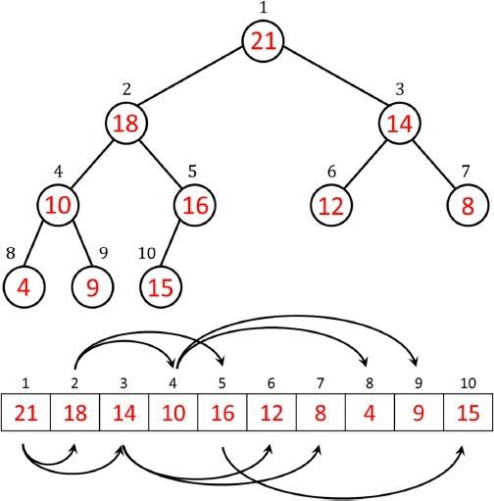
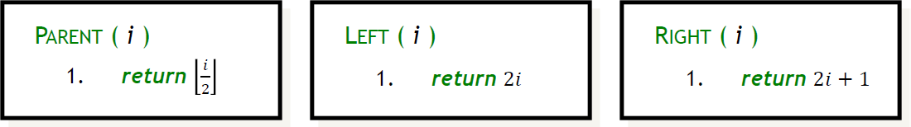
Heap as array
Since heap is a complete tree, we can conveniently represent it as an array
Do not need to represent edges explicitly
Indexing follows the same method as in BT/BST.
Given the index of a node, we can easily compute the indices of its parent, left child and right child.
Heaps

Slide 7
Heap as array properties
The root of the tree is A[1].
A node has 0, 1 or 2 children. (if a node has 1 child, it should be on left side)
A node with no child is called a leaf.
A node with at least one child is called an internal node.
Heaps

Slide 8
Unless explicitly stated as max heap or min heap,
heap means max heap in this course.

Slide 9
Max Heap Property
Each node i > 1 satisfies the max-heap property:
A[Parent(i )] ≥ A[i]. Here, A[i] is an internal node.
Parent always greater than both of its children/child.
Hence, the largest element in a max-heap is stored at the root.
We will use max-heaps in the heapsort algorithm
  It can be viewed as improved selection sort. (In-place)
Heaps

Slide 10
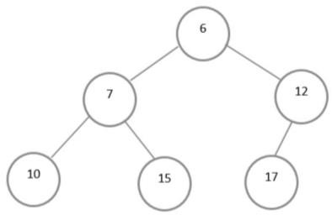
Min Heap Property
Each node i > 1 satisfies the min-heap property:
A[Parent(i )] ≤ A[i]. Here, A[i] is an internal node.
Hence, the smallest element in a min-heap is stored at the root.
Min-heaps commonly implement priority queues which have many applications, e.g., in shortest paths computation.
Heaps

Slide 11
Home Work
Is the array with values (23, 17, 14, 6, 13, 10, 1, 5, 7, 12) a max-heap?
Heaps
18/27

Slide 12
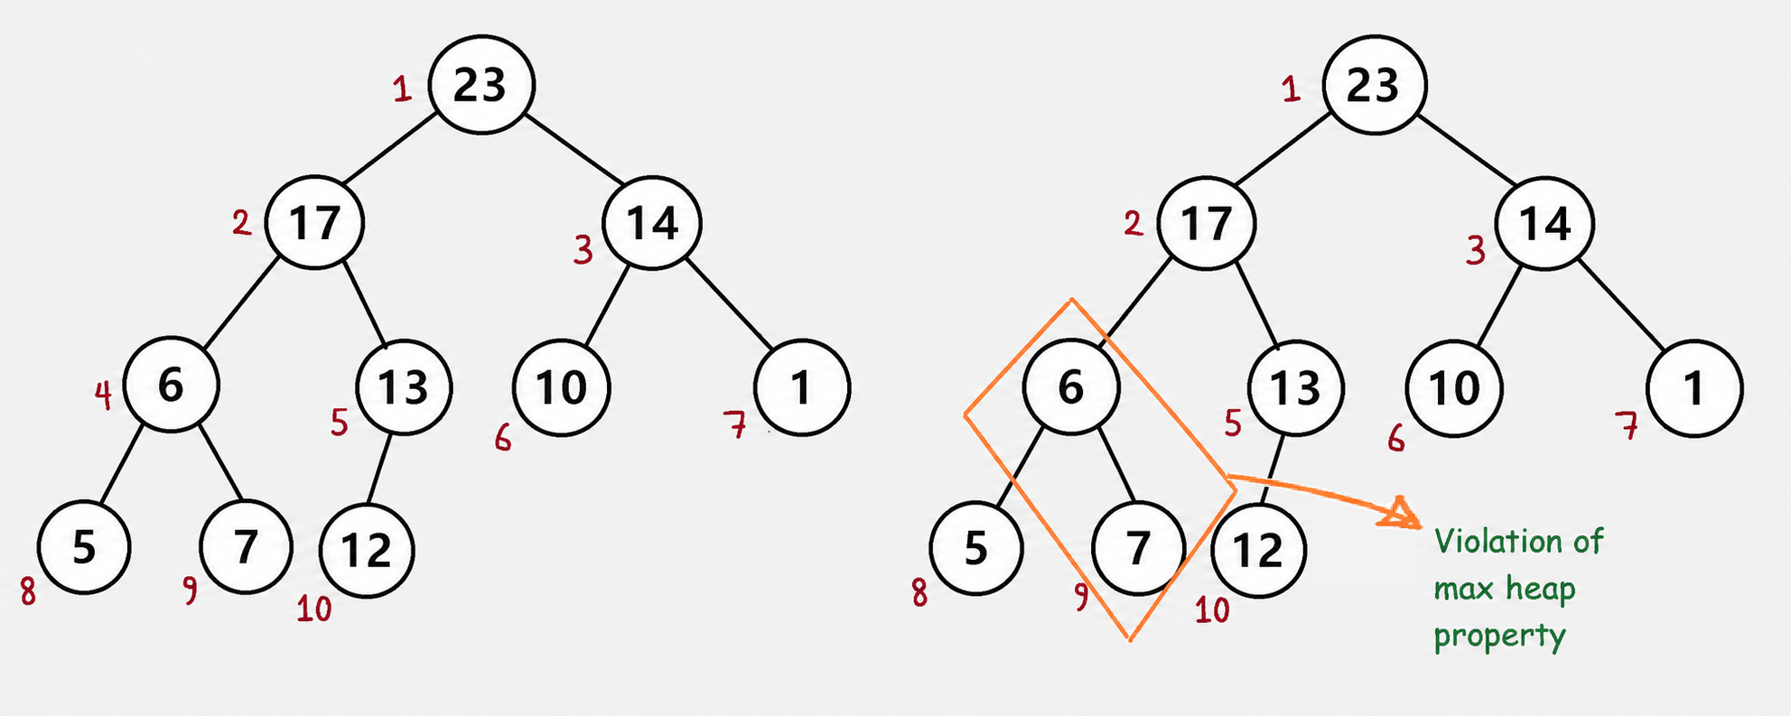
Home Work
Is the array with values (23, 17, 14, 6, 13, 10, 1, 5, 7, 12) a max-heap?
1 2 3 4 5 6 7 8 9 10
Heaps
18/27

Slide 13
Home Work
Is the array with values (23, 17, 14, 6, 13, 10, 1, 5, 7, 12) a max-heap?
1 2 3 4 5 6 7 8 9 10
Heaps
18/27

Slide 14
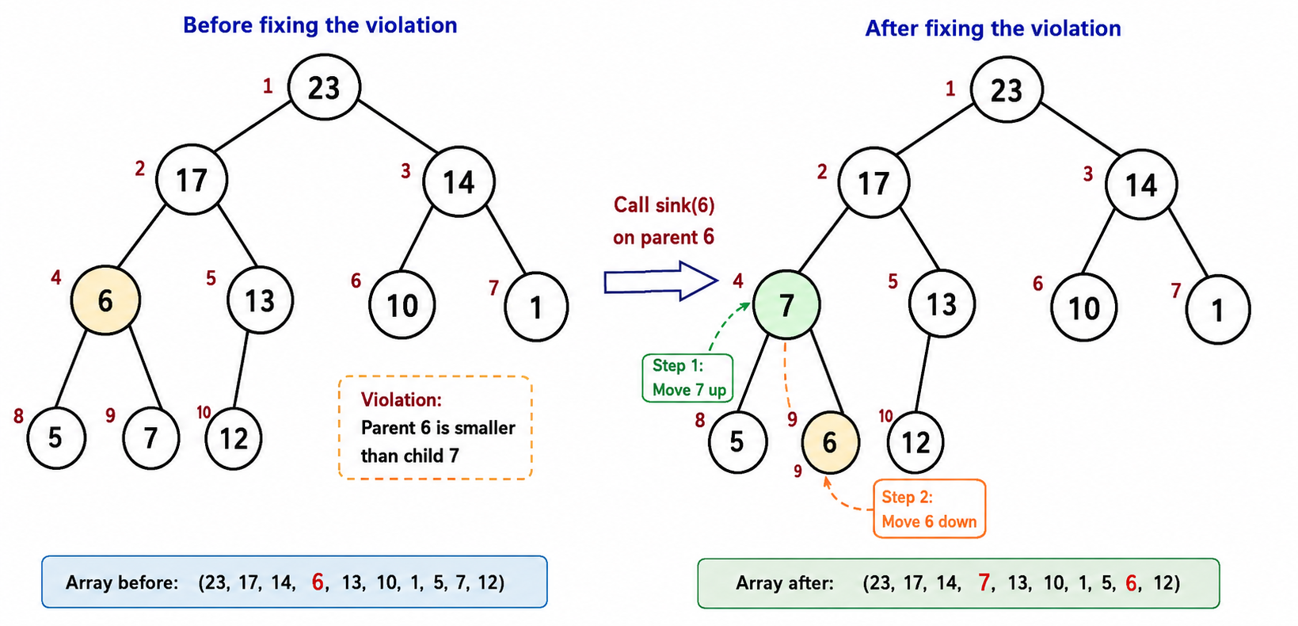
Home Work
Is the array with values (23, 17, 14, 6, 13, 10, 1, 5, 7, 12) a max-heap?
1 2 3 4 5 6 7 8 9 10
Heaps
18/27

Slide 15
Operations on max heap
max-heapify(A, i ) – Ensure the heap property of A, array starting at node i .
- Also known as “sink” operation since it sinks the lighter elements down the tree.
2. heap-increase-key(A, i , key ) – Increase the value of element at node i to key, and ensure the heap property of A by moving larger elements upwards.
- Also known as “swim” operation as it moves larger elements upwards.
3. max-heap-insert(A, key ) – Insert key in the heap A, maintaining A’s heap property.
4. get_maximum(A): return element with largest key
5. heap-extract-max(A) – Extract the largest element from heap A.
- Referred as “Delete_max” in the notes
6. build-max-heap(A) – Build a max heap given an array A.
7. heapsort(A) – Sort the elements in array A using the heap operations.
8. Get_heap_size(): Number of nodes in heap
Heaps
18/27

Slide 16
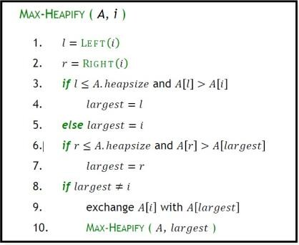
Maintaining the heap property
max-heapify(A, i ) known as “sink” operation
-since it sinks the lighter elements down the tree.
Precondition:
  Subtree rooted at Left(i ) is max heap
  Subtree rooted at Right(i ) is max heap
Postcondition:
After Max − Heapify(A, i ) completes, the subtree rooted at i will be a max heap
Time complexity:
A node may move from root to leaf
So, T(n) = O(h) = O(log n).
Heaps
21/27

Slide 17
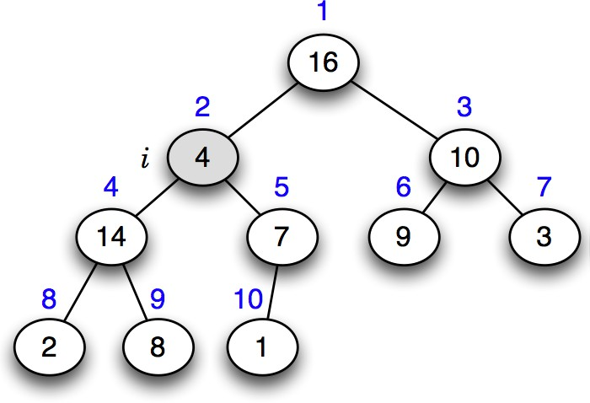
Example of max-heapify (“sink”) operation
Mumit Khan
13 / 29

Slide 18
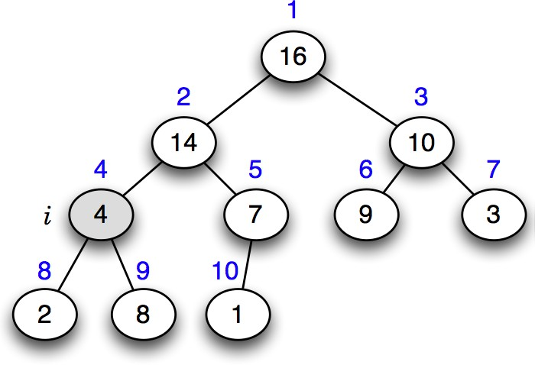
Example of max-heapify (“sink”) operation
Mumit Khan
13 / 29

Slide 19
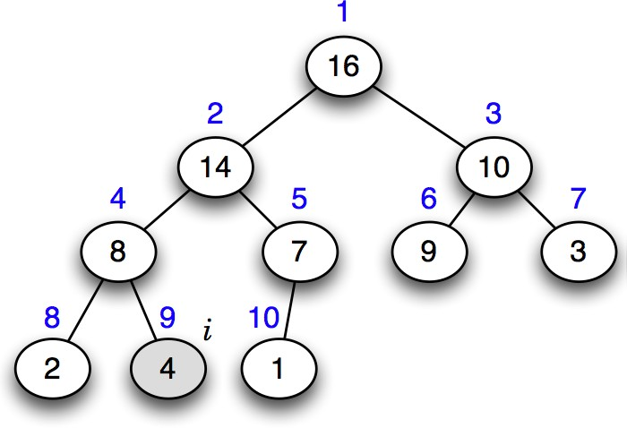
Example of max-heapify (“sink”) operation
Mumit Khan
13 / 29

Slide 20
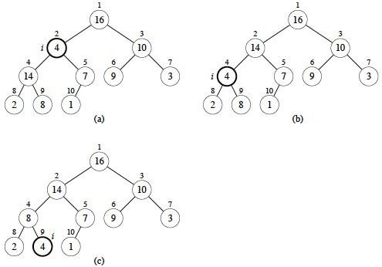
Max − Heapify (“sink”) Example
A= [16, 4, 10, 14, 7, 9, 3, 2, 8, 1]
Heaps
Source: https://www2.hawaii.edu/~nodari/teaching/s18/Notes/Topic-09.html

Slide 21
Heap-increase-key (“swim”) operation algorithm
Known as “swim” operation as it moves larger elements upwards
heap-increase-key(A, i , key )
if key < A[i ]
then error “new key is smaller than current key”
A[i ] ← key
while i > 1 and A[parent(i )] < A[i ]
do exchange A[i ] ↔ A[parent(i )]
i ← parent(i )
Time complexity:
A node may move from leaf to root due to increased value,
So, T(n) = O(h) = O(log n).
Mumit Khan
16 / 29

Slide 22
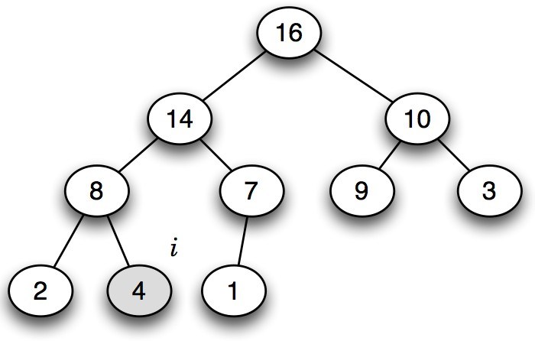
Example of heap-increase-key (“swim”) operation
Mumit Khan
15 / 29

Slide 23

Example of heap-increase-key (“swim”) operation
Mumit Khan
15 / 29

Slide 24
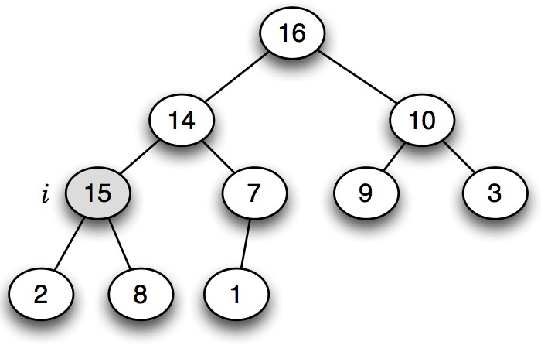
Example of heap-increase-key (“swim”) operation
Mumit Khan
15 / 29

Slide 25
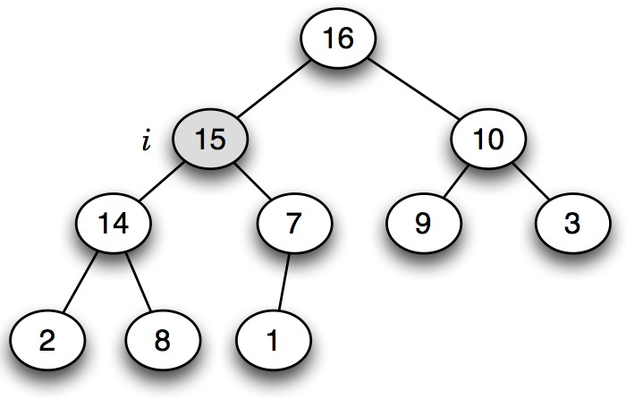
Example of heap-increase-key (“swim”) operation
Mumit Khan
15 / 29

Slide 26
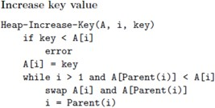
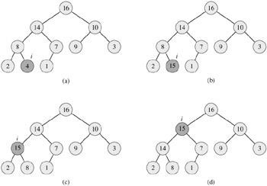
Heap-increase-key (“swim”) operation
(a) The max-heap with a node whose index is i heavily shaded.
(b) This node has its key increased to 15 from 4.
(c) After one iteration of the while loop of lines 4-6, the node and its parent have exchanged keys, and the index i moves up to the parent.
(d) The max-heap after one more iteration of the while loop. At this point, A[PARENT(i)] ≥ A[i]. The max-heap property now holds and the procedure terminates.

Slide 27
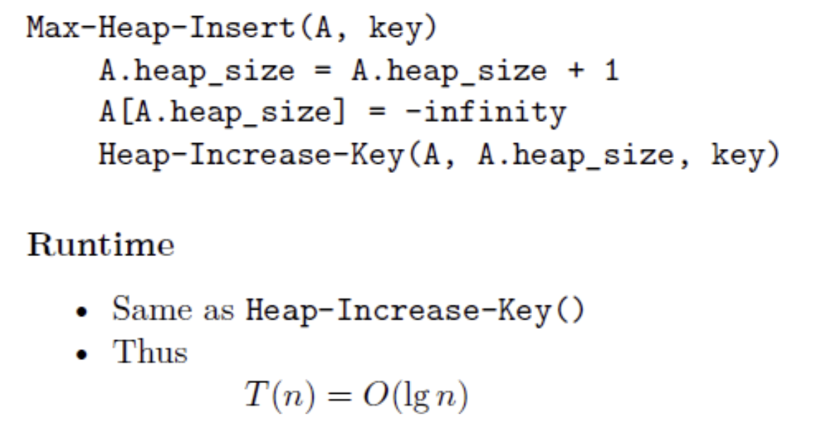
Max heap insert operation
New element always inserted as a last element of the array (leaf)
Then heap-increase-key() is called on that element

Slide 28
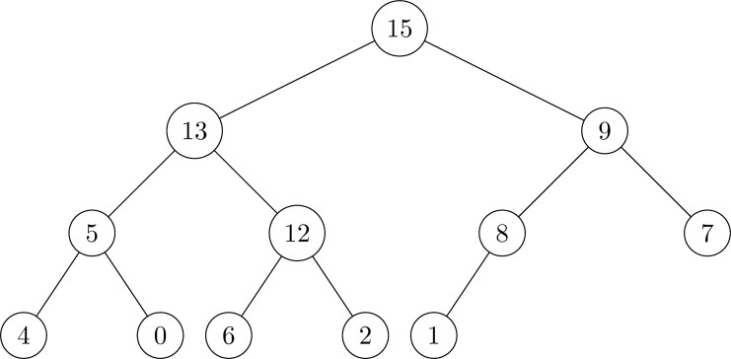
Max heap insert operation (Example1)
Illustrate the operation of MAX-HEAP-INSERT(A,10) on the heap
A=⟨15, 13 , 9, 5, 12, 8, 7, 4, 0, 6, 2, 1, NONE⟩
1 2 3 4 5 6 7 8 9 10 11 12 13
1. Original heap

Slide 29
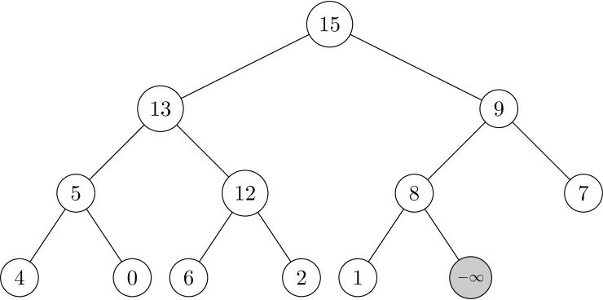
Max heap insert operation (Example1)
Illustrate the operation of MAX-HEAP-INSERT(A,10) on the heap A=⟨15,13,9,5,12,8,7,4,0,6,2,1⟩
2. Since MAX-HEAP-INSERT(A,10) is called, we append a node assigned value −∞

Slide 30
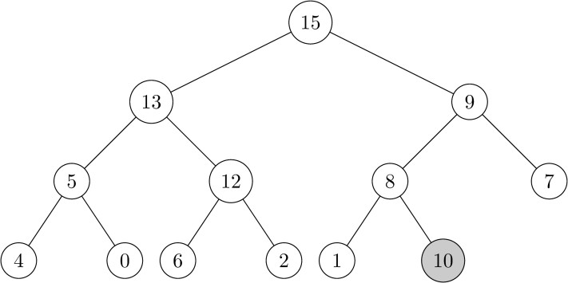
Max heap insert operation (Example1)
Illustrate the operation of MAX-HEAP-INSERT(A,10) on the heap A=⟨15,13,9,5,12,8,7,4,0,6,2,1⟩
3. Update the key value of the new node.

Slide 31
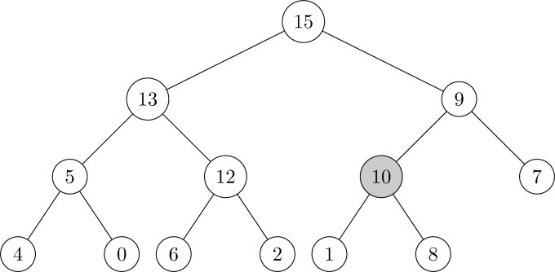
Max heap insert operation (Example1)
Illustrate the operation of MAX-HEAP-INSERT(A,10) on the heap A=⟨15,13,9,5,12,8,7,4,0,6,2,1⟩
4. Update the key value of the new node.

Slide 32
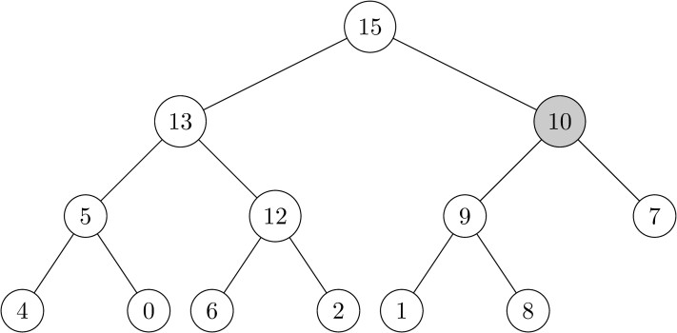
Max heap insert operation (Example1)
Insert into queue - Example
Illustrate the operation of MAX-HEAP-INSERT(A,10) on the heap A=⟨15,13,9,5,12,8,7,4,0,6,2,1⟩
5. Since the parent key is smaller than 10, the nodes are swapped. (Swim up)

Slide 33
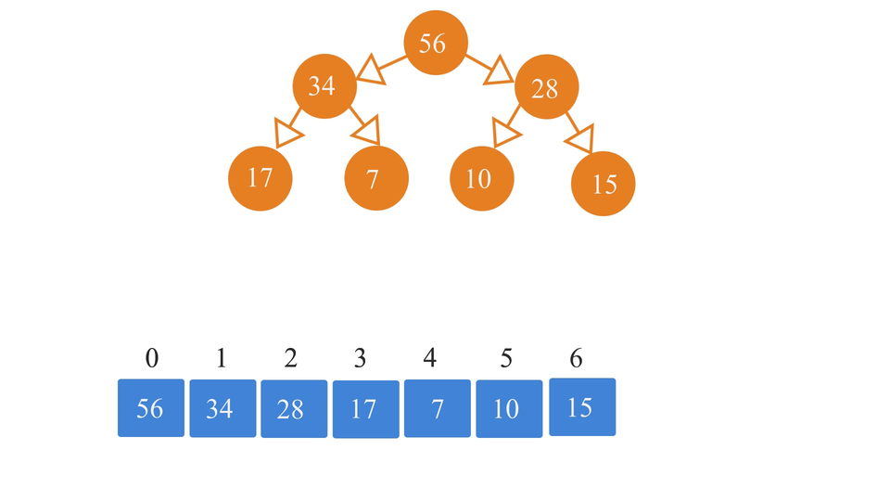
Max heap insert operation (Example2)

Slide 34
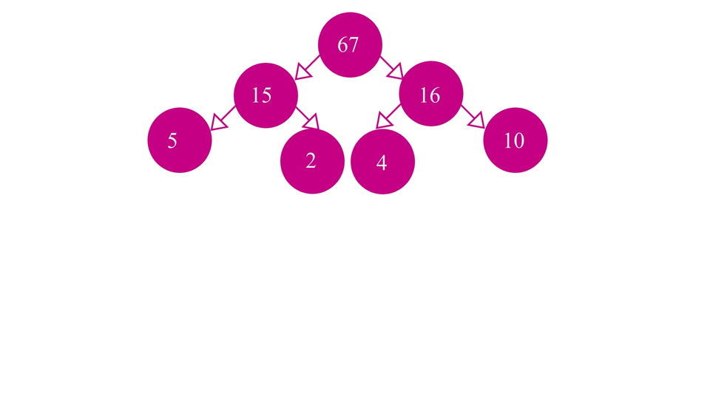
Max heap insert operation (Example3)

Slide 35
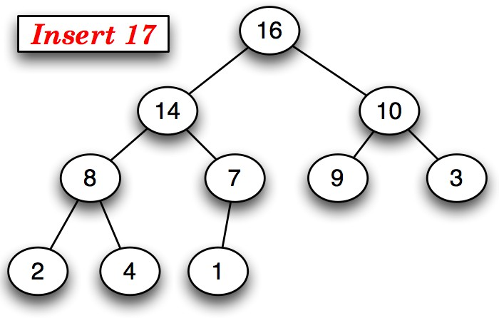
max-heap-insert operation (Example4)
Mumit Khan
17 / 29

Slide 36
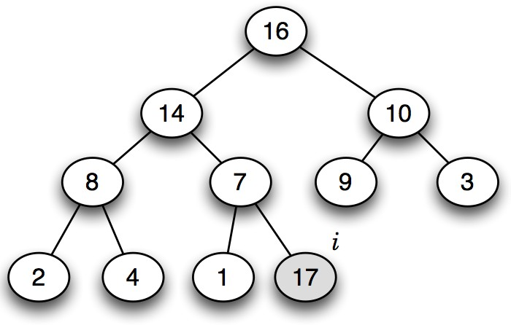
max-heap-insert operation (Example4)
Mumit Khan
17 / 29

Slide 37
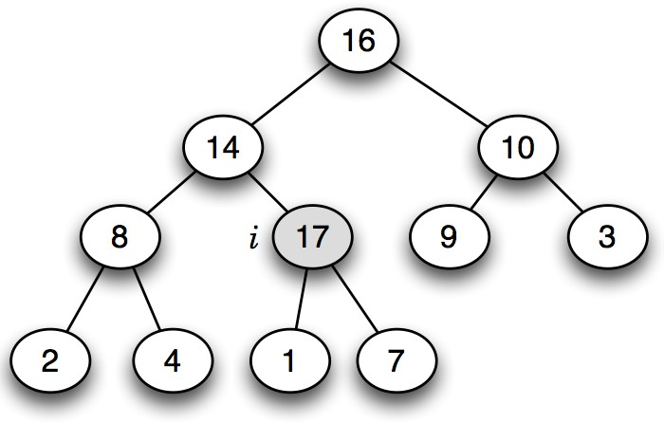
max-heap-insert operation (Example4)
Mumit Khan
17 / 29

Slide 38
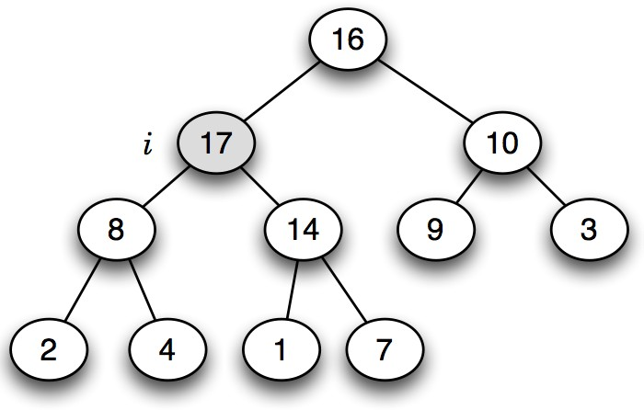
max-heap-insert operation (Example4)
Mumit Khan
17 / 29

Slide 39
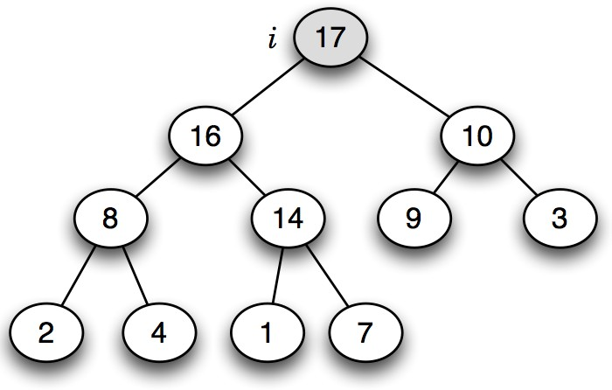
max-heap-insert operation (Example4)
Mumit Khan
17 / 29

Slide 40
Max-heap-insert algorithm (Both ways are correct)
max-heap-insert(A, key )
heap-size[A] ← heap-size[A] + 1
A[heap-size[A]] ← key
i ← heap-size[A]
while i > 1 and A[parent(i )] < A[i ]
do exchange A[i ] ↔ A[parent(i )]
i ← A[parent(i )]
T (n) = O(h) = O(lg n).
Can also be done using heap-increase-key.
max-heap-insert(A, key )
heap-size[A] ← heap-size[A] + 1
A[heap-size[A]] ← −∞
heap-increase-key(A, heap-size[A], key )
Mumit Khan
18 / 29

Slide 41
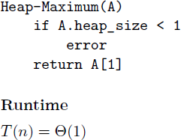
Get maximum value
Priority Queues

Slide 42
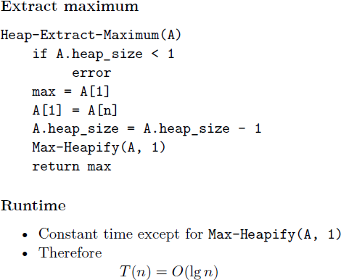
Extract maximum (Referred as “Delete_max/remove” in note)
Here, n = heap_size

Slide 43
heap-extract-max algorithm
extract-max(A)
 | cost | times
1 if heap-size[A] < 1 | Θ(1) | 1
2 then error “heap underflow” | Θ(1) | 1
3 max ← A[1] | Θ(1) | 1
4 A[1] ← A[heap-size[A]] | Θ(1) | 1
5 heap-size[A]] ← heap-size[A] − 1 | Θ(1) | 1
6 max-heapify(A, 1) | Θ(lg n) | 1
Worst-case analysis
T (n) = Θ(lg n)
Mumit Khan
28 / 29

Slide 44
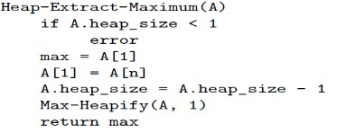
Extract maximum - Example1
Illustrate the operation HEAP-EXTRACT-MAX on the heap A=⟨15,13,9,5,12,8,7,4,0,6,2,1⟩
1. Original heap
Priority Queues

Slide 45
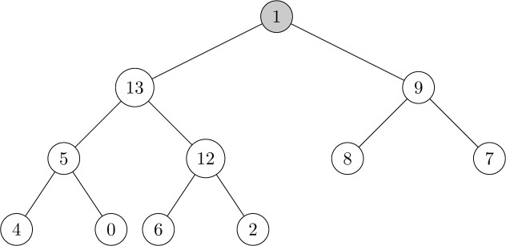
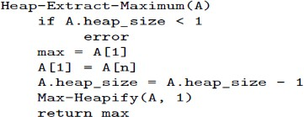
Extract maximum - Example1
Illustrate the operation HEAP-EXTRACT-MAX on the heap A=⟨15,13,9,5,12,8,7,4,0,6,2,1⟩
2. Extract the max node 15, then move 1 to the top of the heap.
Priority Queues

Slide 46
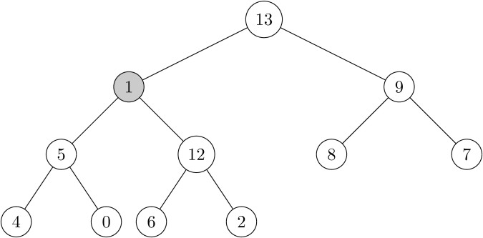
Extract maximum - Example1
Illustrate the operation HEAP-EXTRACT-MAX on the heap A=⟨15,13,9,5,12,8,7,4,0,6,2,1⟩
3. Call max heapify on root. Since 13>9>1, swap 1 and 13.
Priority Queues

Slide 47
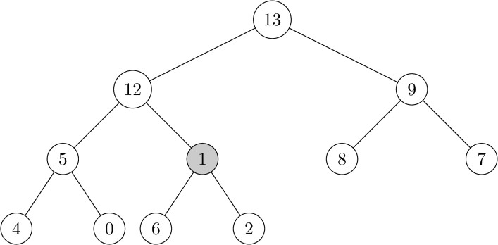
Extract maximum - Example1
Illustrate the operation HEAP-EXTRACT-MAX on the heap A=⟨15,13,9,5,12,8,7,4,0,6,2,1⟩
4. Since 12>5>1, swap 1 and 12.
Priority Queues

Slide 48
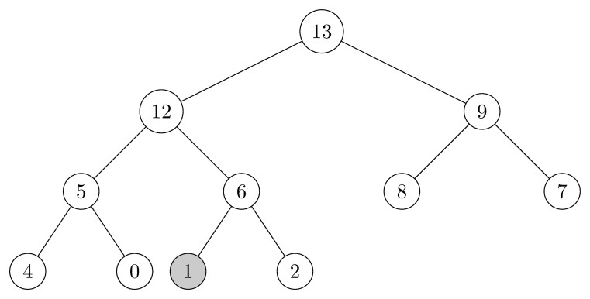
Extract maximum - Example1
Illustrate the operation HEAP-EXTRACT-MAX on the heap A=⟨15,13,9,5,12,8,7,4,0,6,2,1⟩
5. Since 6>2>1, swap 1 and 6
Priority Queues

Slide 49
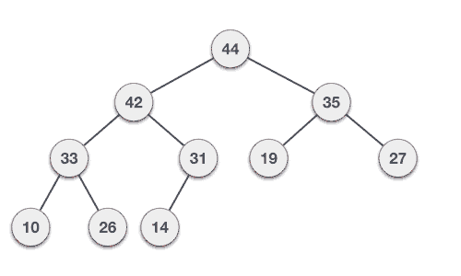
heap-extract-max operation (Example2)
Mumit Khan
27 / 29

Slide 50
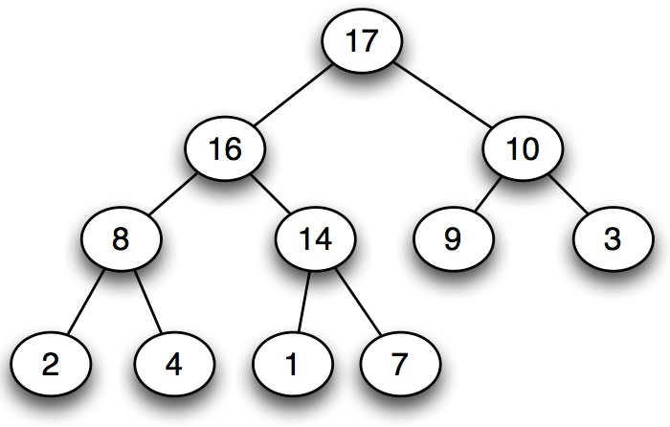
heap-extract-max operation (Example3)
Mumit Khan
27 / 29

Slide 51
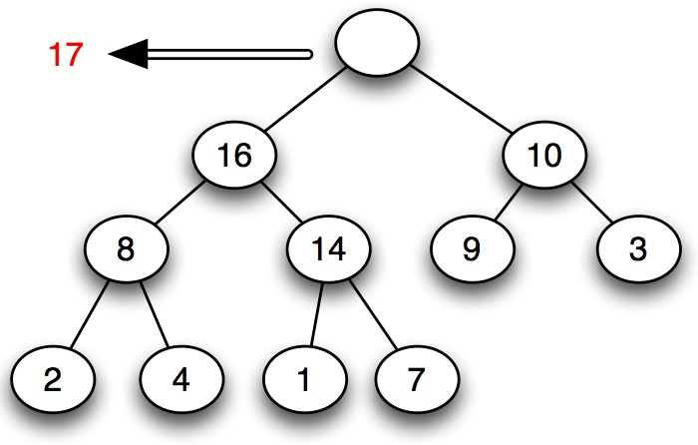
heap-extract-max operation (Example3)
Mumit Khan
27 / 29

Slide 52
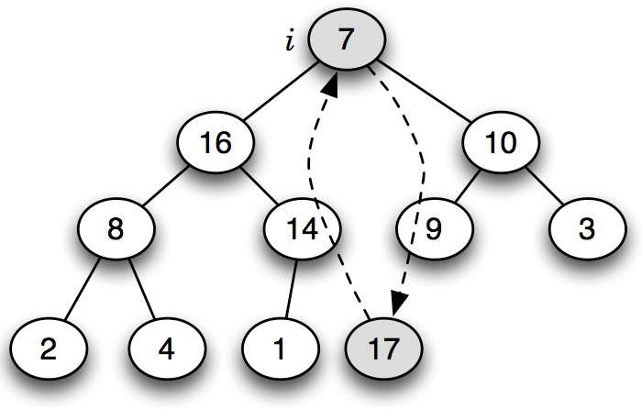
heap-extract-max operation (Example3)
Mumit Khan
27 / 29

Slide 53
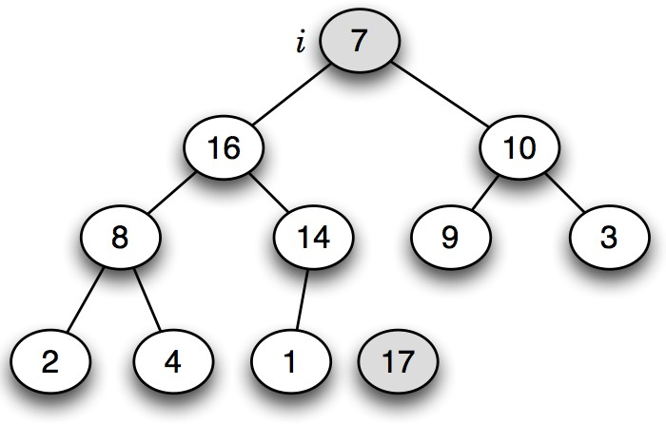
heap-extract-max operation (Example3)
Mumit Khan
27 / 29

Slide 54

heap-extract-max operation (Example3)
Mumit Khan
27 / 29

Slide 55
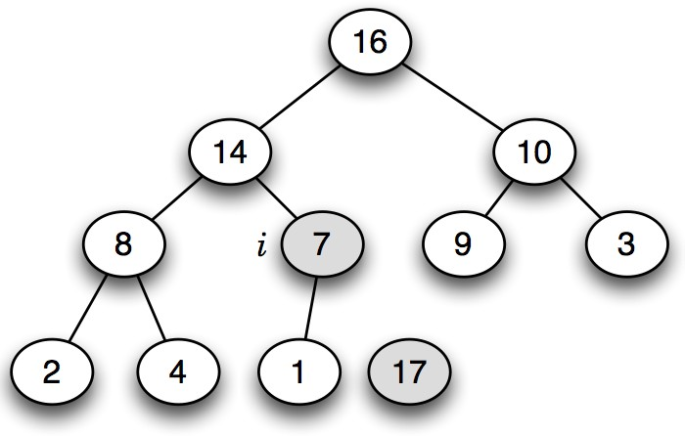
heap-extract-max operation (Example3)
Mumit Khan
27 / 29

Slide 56
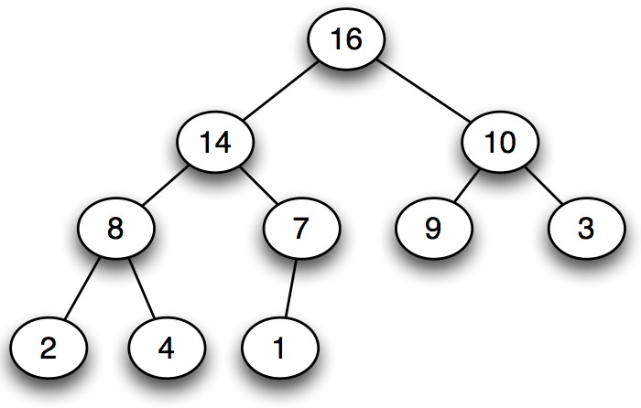
heap-extract-max operation (Example3)
Mumit Khan
27 / 29

Slide 57
Creating a Heap from an Array
Process 1: Using build_max_heap() / build_min_heap()
Call heap.build_max_heap(array) or heap.build_min_heap(array).
The method converts the given array into heap format.
In a MaxHeap, the root/index 1 contains the largest value.
In a MinHeap, the root/index 1 contains the smallest value.
Time Complexity: O(n).
Process 2: Using Repeated Insertions with heap.insert(val)
Create an empty heap object.
Traverse the given array (from start or end).
Insert each value into the heap using heap.insert(val). [always as a leaf]
The heap is formed gradually after each insertion.
Time Complexity: O(n log n)
Heapsort

Slide 58
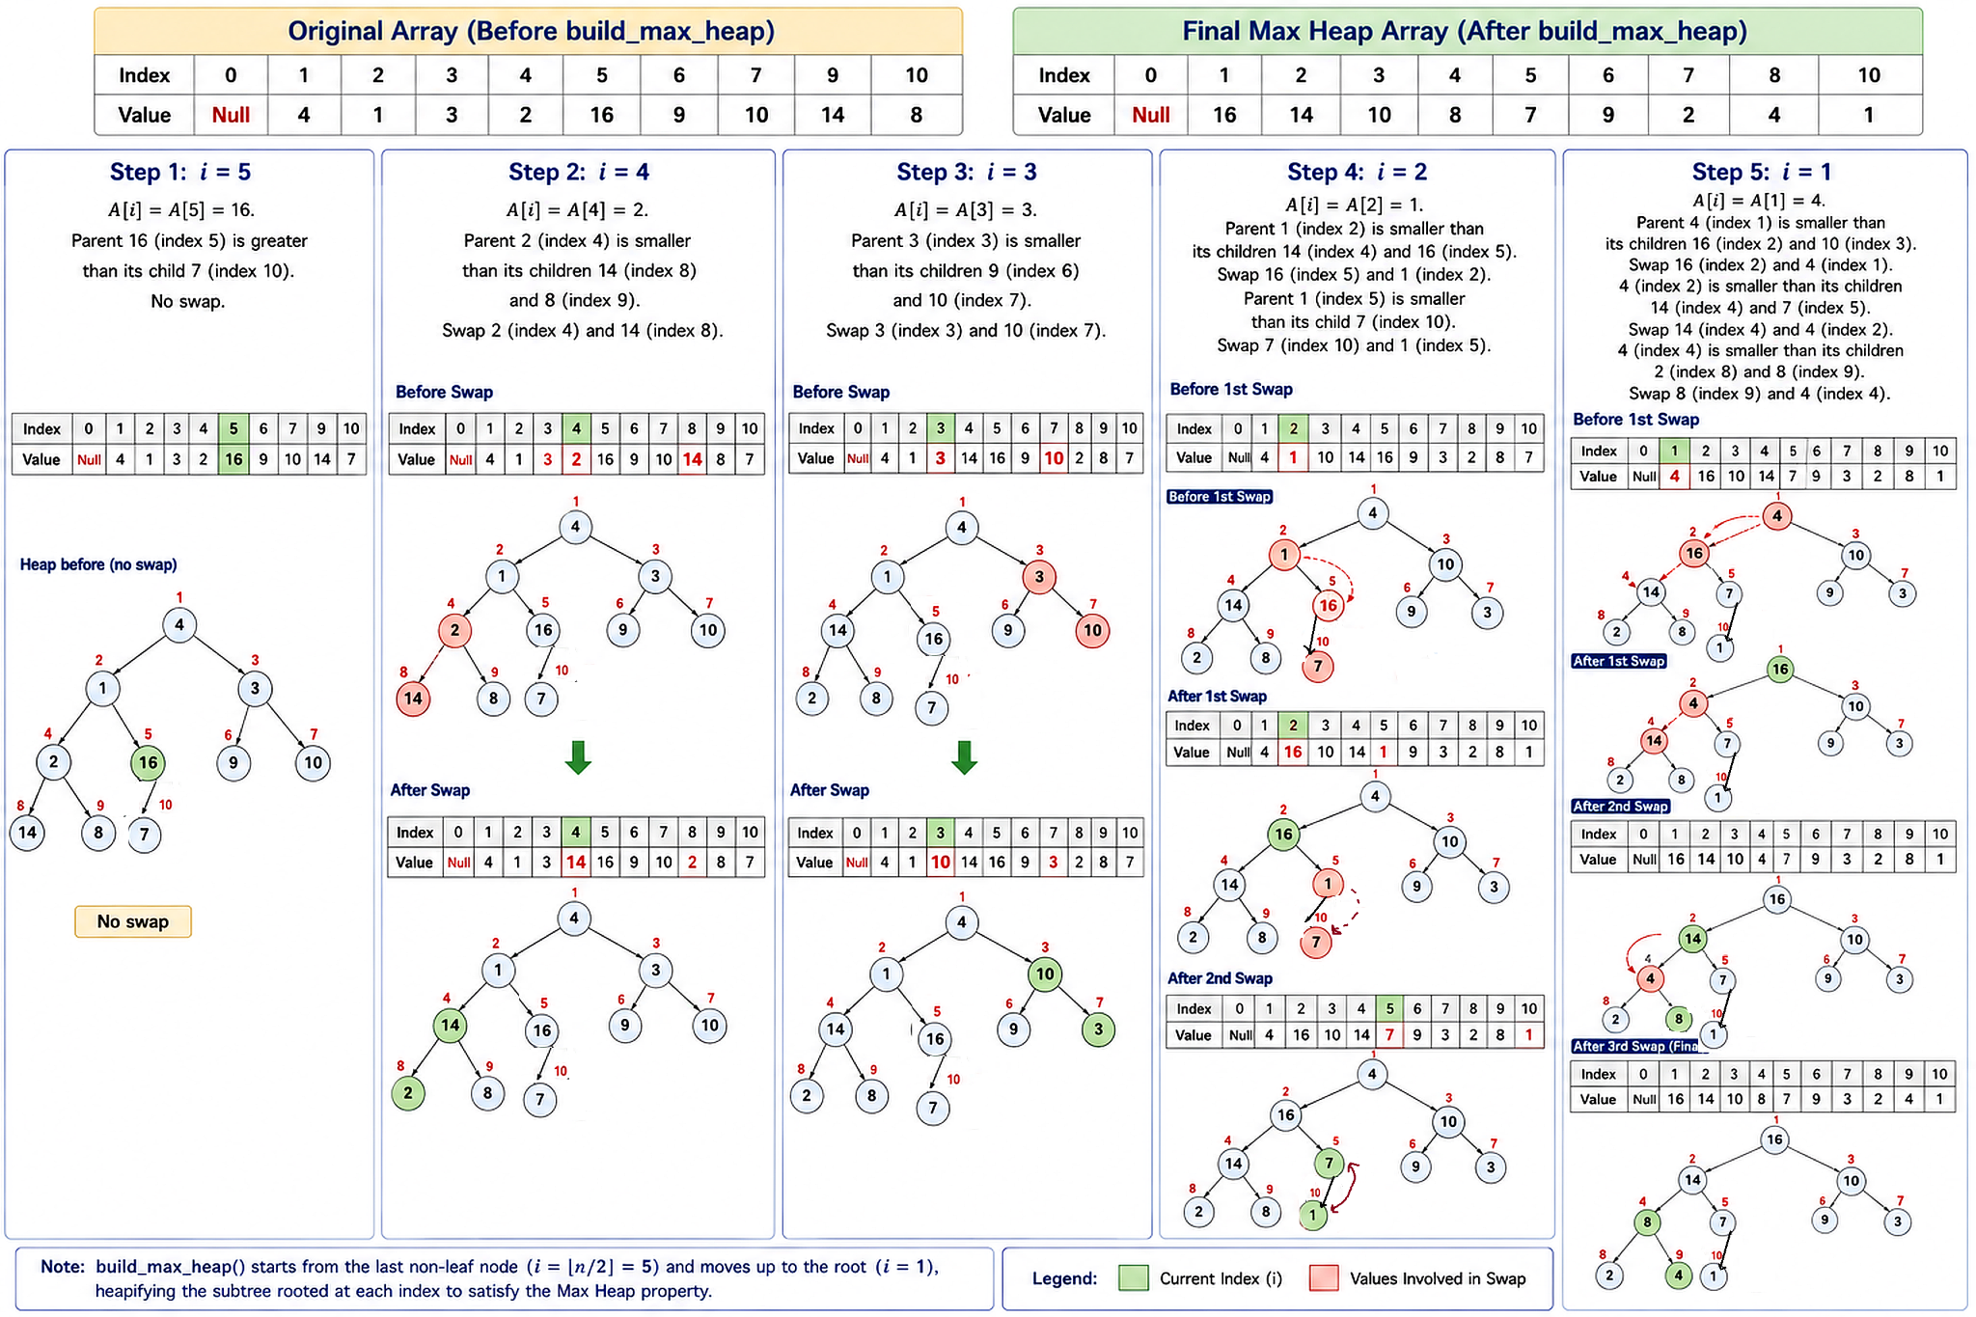
Creating a Heap from an Array Process 1: Using build_max_heap()
Heapsort

Slide 59
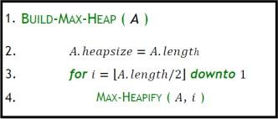
Maintaining the heap property
Goal of build_max_heap() Method:
Transform an unsorted array into a max-heap.
Ensure the heap property:
- Each parent node ≥ its children.
Serve as the foundation for operations like heap sort or priority queues.
Heaps
26/27

Slide 60
Maintaining the heap property
Starting point A[1..n], n = A.length
Goal Turn A, array into a max-heap!
Tool Max-Heapify() algorithm: “sink” operation
Call Max-Heapify() from the last internal node to the root node (1)
Heaps
26/27

Slide 61
Runtime of Build-Max-Heap
From the last internal node to the root
Time complexity:
Max-Heapify(A, i) runs in O(log n)
Build-Max-Heap(A) calls Max-Heapify() n/2 times
Therefore, the runtime of Build-Max-Heap(A) is
= O(n/2) x O(log n)
= O(n log n)
Precise analysis shows most heapify calls are on lower levels (smaller height).
Using the aggregate method, total cost is O(n). Final Time Complexity: O(n).
Heaps

Slide 62
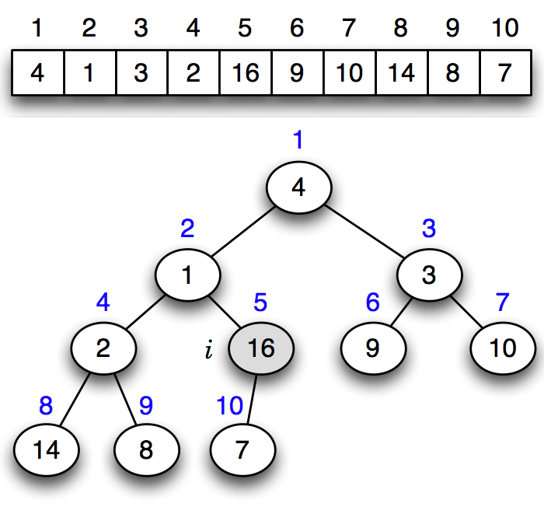
Example of build-max-heap operation
Mumit Khan

Slide 63
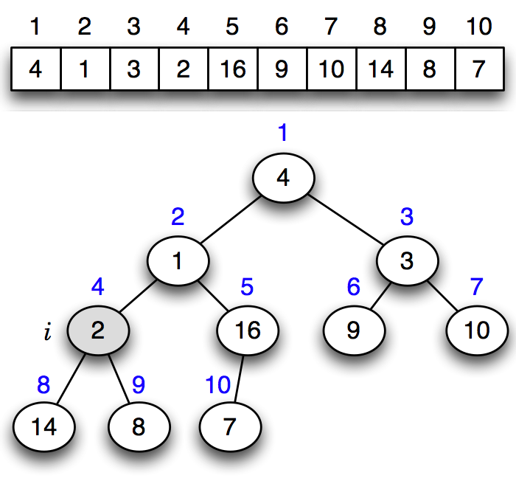
Example of build-max-heap operation
Mumit Khan

Slide 64
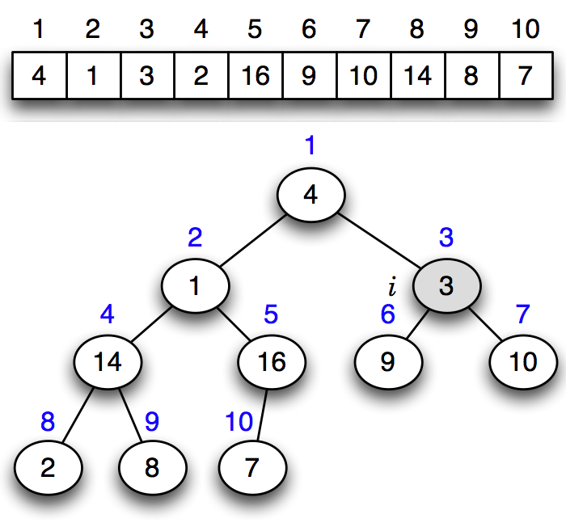
Example of build-max-heap operation
Mumit Khan

Slide 65

Example of build-max-heap operation
Mumit Khan

Slide 66

Example of build-max-heap operation
Mumit Khan

Slide 67

Example of build-max-heap operation
Mumit Khan

Slide 68
Example of build-max-heap operation
Mumit Khan

Slide 69
Example of build-max-heap operation
Simulation available here:
https://docs.google.com/presentation/d/1YKuqIlT2boyiYh8bvBcvpDnDkfqUBXR3/edit?usp=sharing&ouid=100216673605729372437&rtpof=true&sd=true
Mumit Khan

Slide 70
Creating a Heap from an Array (Process 2: Repeated Insertions)
Create the heap gradually by inserting one value at a time.
Algorithm
Given Array (inserted in order)
Index
0
1
2
3
4
5
Create an empty heap object of the given capacity.
Value
–
10
30
4
70
100
1
2
Traverse the array from start to end.
Max Heap Rule
3
Insert each value using heap.insert().
Every parent node must be greater than or equal to its children.
4
After insertion, swim up if the child is greater than its parent.
Final heap: [ 100, 70, 4, 10, 30 ]

Slide 71
Step 0: Empty Heap
0 Empty
1 Insert 10
2 Insert 30
3 Insert 4
4 Insert 70
5 Insert 100
Tree Representation
Action
Simulation Notes
1
Null
No swap is required.
Create an empty heap object. All heap positions are initially Null.
2
3
Null
Null
4
5
Heap Array
Null
Null
1-based index
Index
0
1
2
3
4
5
Current heap: [ Null, Null, Null, Null, Null ]
Value
–
Null
Null
Null
Null
Null
1-based indexing: index 0 is unused

Slide 72
Step 1: Insert 10
0 Empty
1 Insert 10
2 Insert 30
3 Insert 4
4 Insert 70
5 Insert 100
Tree Representation
Action
Simulation Notes
1
Insert 10 at index 1. The heap was empty, so no swap is needed.
10
No swap is required.
2
3
Null
Null
4
5
Heap Array
Null
Null
1-based index
Index
0
1
2
3
4
5
Current heap: [ 10, Null, Null, Null, Null ]
Value
–
10
Null
Null
Null
Null
1-based indexing: index 0 is unused

Slide 73
Step 2: Insert 30
0 Empty
1 Insert 10
2 Insert 30
3 Insert 4
4 Insert 70
5 Insert 100
Tree Representation
Action
Simulation Notes
1
Insert 30 at index 2. Since 30 > 10, swim 30 up by swapping with its parent.
30
Swap 30 with 10.
2
3
10
Null
4
5
Heap Array
Null
Null
1-based index
Index
0
1
2
3
4
5
Current heap:
[ 30, 10, Null, Null, Null ]
Value
–
30
10
Null
Null
Null
1-based indexing: index 0 is unused

Slide 74
Step 3: Insert 4
0 Empty
1 Insert 10
2 Insert 30
3 Insert 4
4 Insert 70
5 Insert 100
Tree Representation
Action
Simulation Notes
1
Insert 4 at index 3. Since 4 < 30, the max heap property already holds.
30
No swap is required.
2
3
10
4
4
5
Heap Array
Null
Null
1-based index
Index
0
1
2
3
4
5
Current heap:
[ 30, 10, 4, Null, Null ]
Value
–
30
10
4
Null
Null
1-based indexing: index 0 is unused

Slide 75
Step 4: Insert 70
0 Empty
1 Insert 10
2 Insert 30
3 Insert 4
4 Insert 70
5 Insert 100
Tree Representation
Action
Simulation Notes
1
Insert 70 at index 4. Swim up twice because 70 is greater than both 10 and 30.
70
Swap 70 with 10.
2
3
Swap 70 with 30.
30
4
4
5
Heap Array
10
Null
1-based index
Index
0
1
2
3
4
5
Current heap:
[ 70, 30, 4, 10, Null ]
Value
–
70
30
4
10
Null
1-based indexing: index 0 is unused

Slide 76
Step 5: Insert 100
0 Empty
1 Insert 10
2 Insert 30
3 Insert 4
4 Insert 70
5 Insert 100
Tree Representation
Action
Simulation Notes
1
Insert 100 at index 5. Swim up twice because 100 is greater than 30 and 70.
100
Swap 100 with 30.
2
3
Swap 100 with 70.
70
4
4
5
Heap Array
10
30
1-based index
Index
0
1
2
3
4
5
Final heap: [ 100, 70, 4, 10, 30 ]
Value
–
100
70
4
10
30
1-based indexing: index 0 is unused

Slide 77
Final Max Heap
Final Tree
Final Heap Array
1
1-based index
100
Index
0
1
2
3
4
5
Value
–
100
70
4
10
30
2
3
70
4
[ 100, 70, 4, 10, 30 ]
4
5
10
30
The root contains the maximum value, and every parent is greater than or equal to its children.
1-based indexing: index 0 is unused

Slide 78

Creating a Heap from an Array
Heapsort

Slide 79
Heapsort (Original/Standard/In-place) Algorithm
Starting point Any array A[1..n]
Goal Array sorted in ascending order, in-place.
Works like selection sort by dividing input into sorted and unsorted regions
In-Place Sorting: Sorting is performed without using extra space for another array, only modifying the input array.
Examples of In-Place Sorting Algorithms
Bubble Sort, Selection Sort, Insertion Sort, Heapsort, Quicksort
For In-Place Sorting, Space complexity is O(1)
Original heapsort algorithm is ALWAYS in-place.
Heaps

Slide 80
Heapsort (Original/Standard/In-place) Algorithm (Important!!!)
Differences in Sorting Order
Max Heap: Sorts in ascending order by repeatedly moving the largest elements to the end.
Min Heap: Sorts in descending order by repeatedly moving the smallest elements to the end.
Heap Type | Sorting Order | Key Element Moved | Re-Heapify Operation
Max Heap | Ascending Order | Largest to End | Maintain Max Heap, calls max-heapify
Min Heap | Descending Order | Smallest to End | Maintain Min Heap, calls min-heapify
Heaps

Slide 81

Heapsort (Original/Standard) Algorithm
Explanation
Turn A[1..n] into max-heap.
A[1] is now largest element.
Swap A[1] and A[n], n=heap_size
Reduce heap size to n - 1
and call max-heapify on the root
5.Now, A[n] contains largest element (is sorted) and A[1..n - 1] is max-heap.
Repeat until entire array is sorted.
Works like selection sort by dividing input into sorted and unsorted regions.
Heapsort

Slide 82

Heapsort (Original/Standard) Algorithm
Source: https://www.lavivienpost.net/heapsort-gif/

Slide 83
Heapsort (Original/Standard) Algorithm
Line |  | Time cost | times
In-place-heapsort(A):
1 | build-max-heap(A) | O(n) | 1
2 | for i ← length[A] downto 2 | O(1) | n
3 | do exchange A[1] ↔ A[i ] | O(1) | n − 1
4 | heap-size[A] ← heap-size[A] − 1 | O(1) | n − 1
 | max-heapify(A, 1) [Iterative] | O(lg n) | n − 1
Worst-Case Time Analysis
T(n) = O(n) + O(n) x (O(1) + O(1) + O(lg n) )
T(n) = O(n) + O(n lg n)
T(n) = O(n lg n)
Mumit Khan
24 / 29

Slide 84
Heapsort (Original/Standard) Algorithm
Line |  | Space cost | Explanation
In-place-heapsort(A):
1 | build-max-heap(A) | O(1) | Heap is built inside the original array; no additional array is created.
2 | for i ← length[A] downto 2 | O(1) | Only loop variable i is used.
3 | do exchange A[1] ↔ A[i ] | O(1) | Only one temporary variable is needed for swapping.
4 | heap-size[A] ← heap-size[A] − 1 | O(1) | Only the heap-size variable is updated.
 | max-heapify(A, 1) [Iterative] | O(1) | Uses only a few variables; no extra array.
Worst-Case Space Analysis
S(n) = O(1) [In-place sorting]
Mumit Khan
24 / 29

Slide 85
Heapsort (Original/Standard) Algorithm
heapsort(A)
 | cost | times
1 build-max-heap(A) | Θ(n) | 1
2 for i ← length[A] downto 2 | Θ(1) | n
3 do exchange A[1] ↔ A[i ] | Θ(1) | n − 1
4 heap-size[A] ← heap-size[A] − 1 Θ(1) |  | n − 1
5 max-heapify(A, 1) | Θ(lg n) | n − 1
Analysis
T (n) = Θ(n)+ Θ(n lg n) = Θ(n lg n)
Space Complexity: S(n) = Θ(1)
Mumit Khan
24 / 29

Slide 86

Heapsort (Original/Standard) Algorithm
Source: https://yaswa779.medium.com/introduction-to-heap-sort-edad68e6b0d1
Mumit Khan
24 / 29

Slide 87

Heapsort (Original/Standard) Algorithm Simulation
Mumit Khan
23 / 29

Slide 88

Heapsort (Original/Standard) Algorithm Simulation
Mumit Khan
23 / 29

Slide 89

Heapsort (Original/Standard) Algorithm Simulation
Mumit Khan
23 / 29

Slide 90

Heapsort (Original/Standard) Algorithm Simulation
Mumit Khan
23 / 29

Slide 91

Heapsort (Original/Standard) Algorithm Simulation
Mumit Khan
23 / 29

Slide 92

Heapsort (Original/Standard) Algorithm Simulation
Mumit Khan
23 / 29

Slide 93

Heapsort (Original/Standard) Algorithm Simulation
Mumit Khan
23 / 29

Slide 94

Heapsort (Original/Standard) Algorithm Simulation
Mumit Khan
23 / 29

Slide 95

Heapsort (Original/Standard) Algorithm Simulation
Mumit Khan
23 / 29

Slide 96

Heapsort (Original/Standard) Algorithm Simulation
Mumit Khan
23 / 29

Slide 97

Heapsort (Original/Standard) Algorithm Simulation
Mumit Khan
23 / 29

Slide 98

Heapsort (Original/Standard) Algorithm Simulation
Mumit Khan
23 / 29

Slide 99

Heapsort (Original/Standard) Algorithm Simulation
Heapsort

Slide 100
Why Original/In-Place HeapSort “Ruins” the Heap
During in-place HeapSort,
the maximum/minimum element is repeatedly extracted from the heap.
As extraction continues, the heap gradually becomes empty.
The original heap array is transformed into a sorted array.
Therefore, the array can no longer be used as a valid heap structure after sorting.
Heapsort

Slide 101
Modified/Out-of-Place HeapSort
The original array is not converted into a heap directly.
Instead:
Create a separate empty heap object.
Insert all array elements into the heap.
Extract elements one by one from the heap.
Store the extracted values back into the original array.
Heapsort

Slide 102
Why It Is Called “Out-of-Place”
Sorting does not happen inside the original array.
An additional heap object is used during the sorting process.
Hence, it is called Out-of-Place HeapSort.
Heapsort

Slide 103
Modified/Out-of-Place HeapSort
Line | Algorithm | TimeCost | Times
Modified Out-of-Place HeapSort(A):
1 | H ← new MaxHeap(length[A]) | O(n) | 1
2 | for i ← 1 to length[A] | O(1) | n
3 | do H.insert(A[i]) [Iterative] | O(lg n) | n
4 | for i ← length[A] downto 1 | O(1) | n
5 | do A[i] ←H.extractMax() [Iterative] | O(lg n) | n
Worst-Case Time Analysis
T(n) = O(n) + O(n lg n) + O(n lg n)
T(n) = O(n lg n)
Heap creation: O(n)
n insertions: O(nlogn)
n extractions: O(nlogn)

Slide 104
Modified/Out-of-Place HeapSort
Line | Algorithm | SpaceCost | Explanation
Modified Out-of-Place HeapSort(A):
1 | H ← new MaxHeap(length[A]) | O(n) | Creates a separate heap with an internal array of size n.
2 | for i ← 1 to length[A] | O(1) | Only loop variable i is required.
3 | do H.insert(A[i]) [Iterative] | O(1) | Inserts into the already allocated heap array; only temporary variables are required.
4 | for i ← length[A] downto 1 | O(1) | Only loop variable i is required.
5 | do A[i] ← H.extractMax() [Iterative] | O(1) | Uses the existing heap array and a constant number of temporary variables.
Worst-Case Space Analysis
S(n) = O(n)+O(1)+O(1)+O(1)+O(1) = O(n) [Because an additional heap object H with an internal array of size n is created.]

Slide 105

Heapsort

Slide 106
Modified/Out-of-Place HeapSort
Main Advantage
The original heap structure does not get destroyed or “ruined.”
Useful when the heap needs to be preserved for later operations.
Main Disadvantage
An additional heap object must be created.
Requires additional memory: O(n) extra space. Space complexity: O(n)
Heapsort

Slide 107
Comparison between Inplace and Out-of-Place HeapSort
HeapSort Version | Sorting Type | Worst-Case Time Complexity | Worst-Case Auxiliary Space
Original / In-Place HeapSort | In-place | O(nlogn) | O(1)
Modified / Out-of-Place HeapSort | Out-of-place | O(nlogn) | O(n)
Key difference: Both have the same worst-case time complexity,
but the modified version requires an additional heap object with an internal array of size n,
so its space complexity becomes O(n).
Heapsort

Slide 108
Important Notes regarding HeapSort
Modified/Out-of-Place HeapSort is not the standard HeapSort implementation. (Important!!!!)
Standard/original HeapSort is generally preferred because:
It is an in-place sorting algorithm [Space complexity is O(1)]
More memory efficient than the out-of-place version.
Heapsort

Slide 109
Try out Interactive Max Heap Simulation by Visualgo.net (https://visualgo.net/en/heap)
Interactive simulations

Slide 110
The End

